Slide 1

Lesson 1: Introduction

Slide 2


Slide 3
Lesson plan:
Self introduction
Study plan
Java Core
Java for Web
Online\Offline lessons
Homework
Programming technologies
Q&A

Slide 4
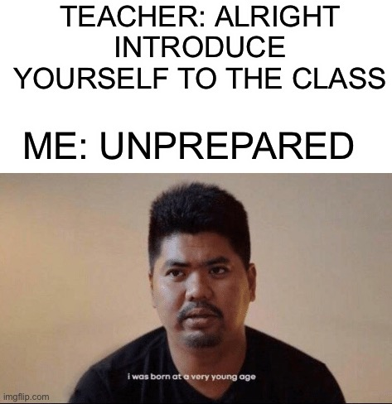
Introduction
Name
Goals and expectations
Something about yourself

Slide 5



Main Lecturers
Vladyslav Nikolenko
Bohdan Cherniak
Volodymyr Vedula

Slide 6



Lecturers Assistants
Yaroslav Brahinets
Vasya Rudas
Andrii Yeromenko

Slide 7

Study Plan: Java Core
Introduction
Basics
Object-oriented Programming
Error Propagation and Handling
Code Testing (Unit)
Practice
7. Generics. Collections Framework
8. Functional Programming, Stream API, Optional
9. Input/Output, DateTime Api
10. Reflection API
11. Concurrency
12. Practice
*Practice can be added or removed on the fly

Slide 8

Study Plan: Java for Web
Web introduction
Gradle, CI
Spring IoC
JDBC, Spring JDBC, Flyway
Spring MVC, Boot
REST, Swagger
Front End
Microservices
9. Spring Security p1.
10. Spring Security p2
11. Integration Testing
12. CD
13. Course works preview
14. Docker
15. Course works review
*Practice can be added or removed on the fly

Slide 9
Lessons
Some lessons will be online, but mostly offline
All lessons can be visited online
All lessons are recorded
All lessons have homework

Slide 10
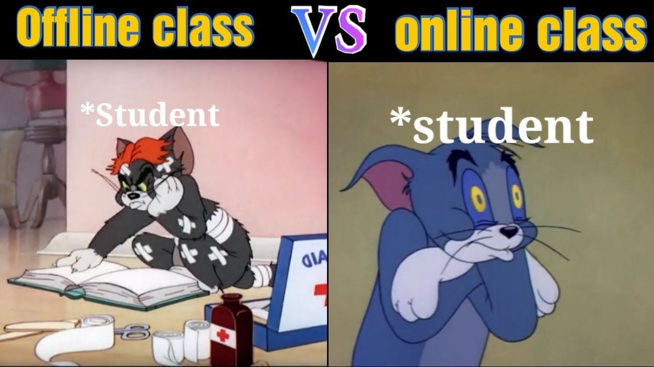
Why Offline is better?
Better communication with lecturer
Better focus
Better sound
Candies

Slide 11


Homework
After each lesson you will get a homework
Every homework has a deadline until Sunday
Each homework is reviewed by the lecturer
After review, lecturer gives feedback that you need to apply to your homework
Before you finish and apply all of the homework review recommendations, you cannot move on to the next homework
Each homework is graded by the teacher.

Slide 12
Homework types
Java Core | Java for Web
Every homework task will be dedicated only to specific topic and code will not be related on previous homeworks | Every homework task related to each other and as a final result we will get an fully functional project

Slide 13

Homework quality control
Code is formatted
Code is organized
Code is verified
Tools that can help:
CheckStyle
EditorConfig
SonarLint

Slide 14

Good coding practices
Java Code Convention: by Google, by Oracle
Clean code principles
40 Tips that will change your coding skills forever
Developers jargon
Books:
“Clean Code” and other by Robert Martin
“Java: The Complete Reference” by Herbert Schildt

Slide 15
Questions & Answers
“Asking questions is a good way to learn more”
@Yaroslav Brahinets

Slide 16
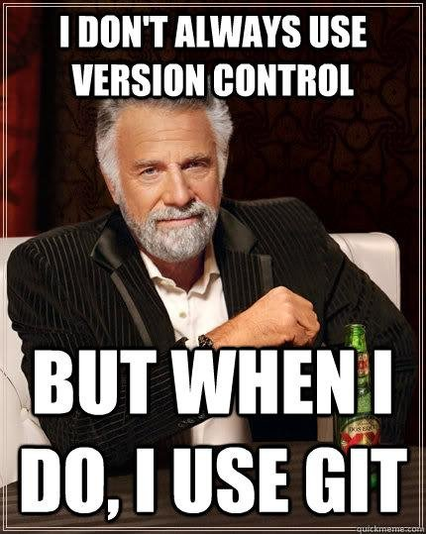
Version Control
Version control, also known as source control, is the practice of tracking and managing changes to software code.
Version control systems are software tools that help software teams manage changes to source code over time.

Slide 17

Programming technologies: Git
“Git is free and open source software for distributed version control: tracking changes in any set of files, usually used for coordinating work among programmers collaboratively developing source code during software development.”
@Wikipedia
Download Git from the official website or GitHub instruction.

Slide 18
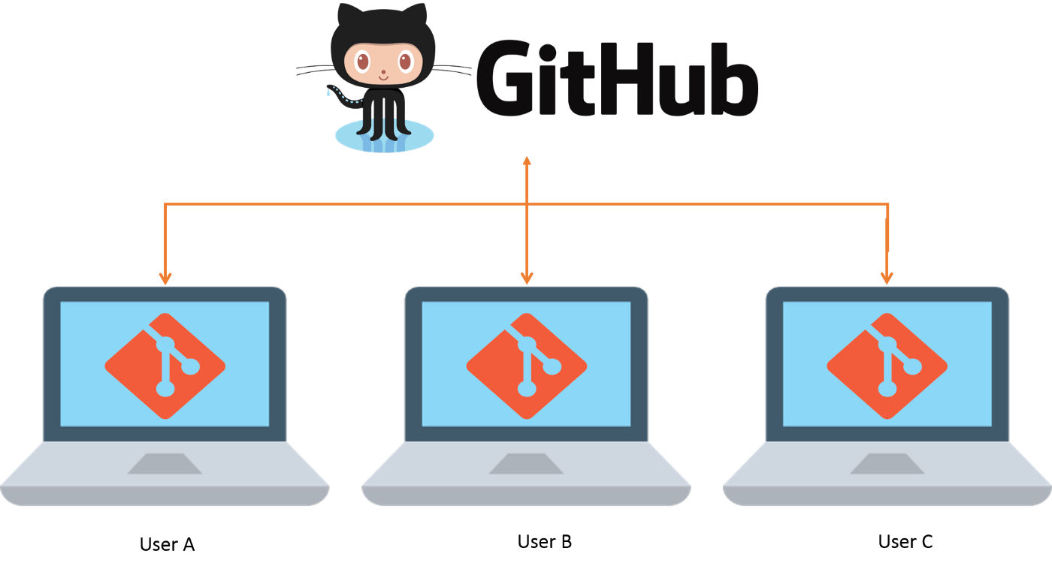

Programming technologies: GitHub
“GitHub is an online software development platform used for storing, tracking, and collaborating on software projects. It enables developers to upload their own code files and to collaborate with fellow developers on open-source projects.”
@HubSpot

Slide 19
Student GitHub account
Go to the github page and register new account. Your student account should match following rules:
Account should be registered on your real name.
Use your full name as nickname for your account
Upload your photo (same as for slack) as avatar

Slide 20
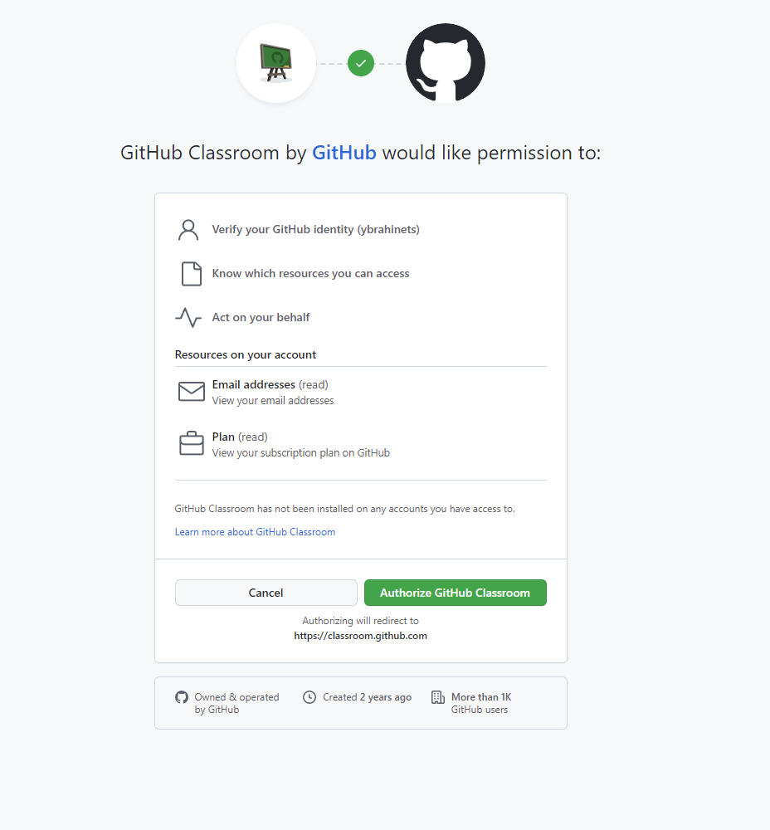

GitHub classroom
You can join GeekHub via link or QR code:

Slide 21
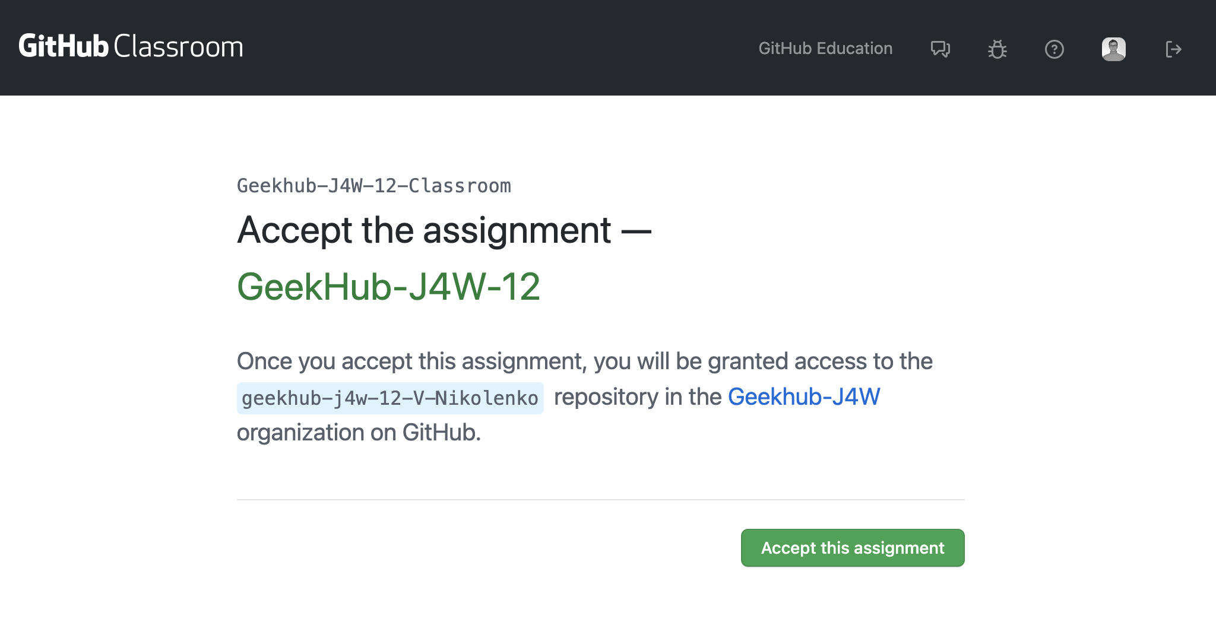
Join GitHub classroom

Slide 22
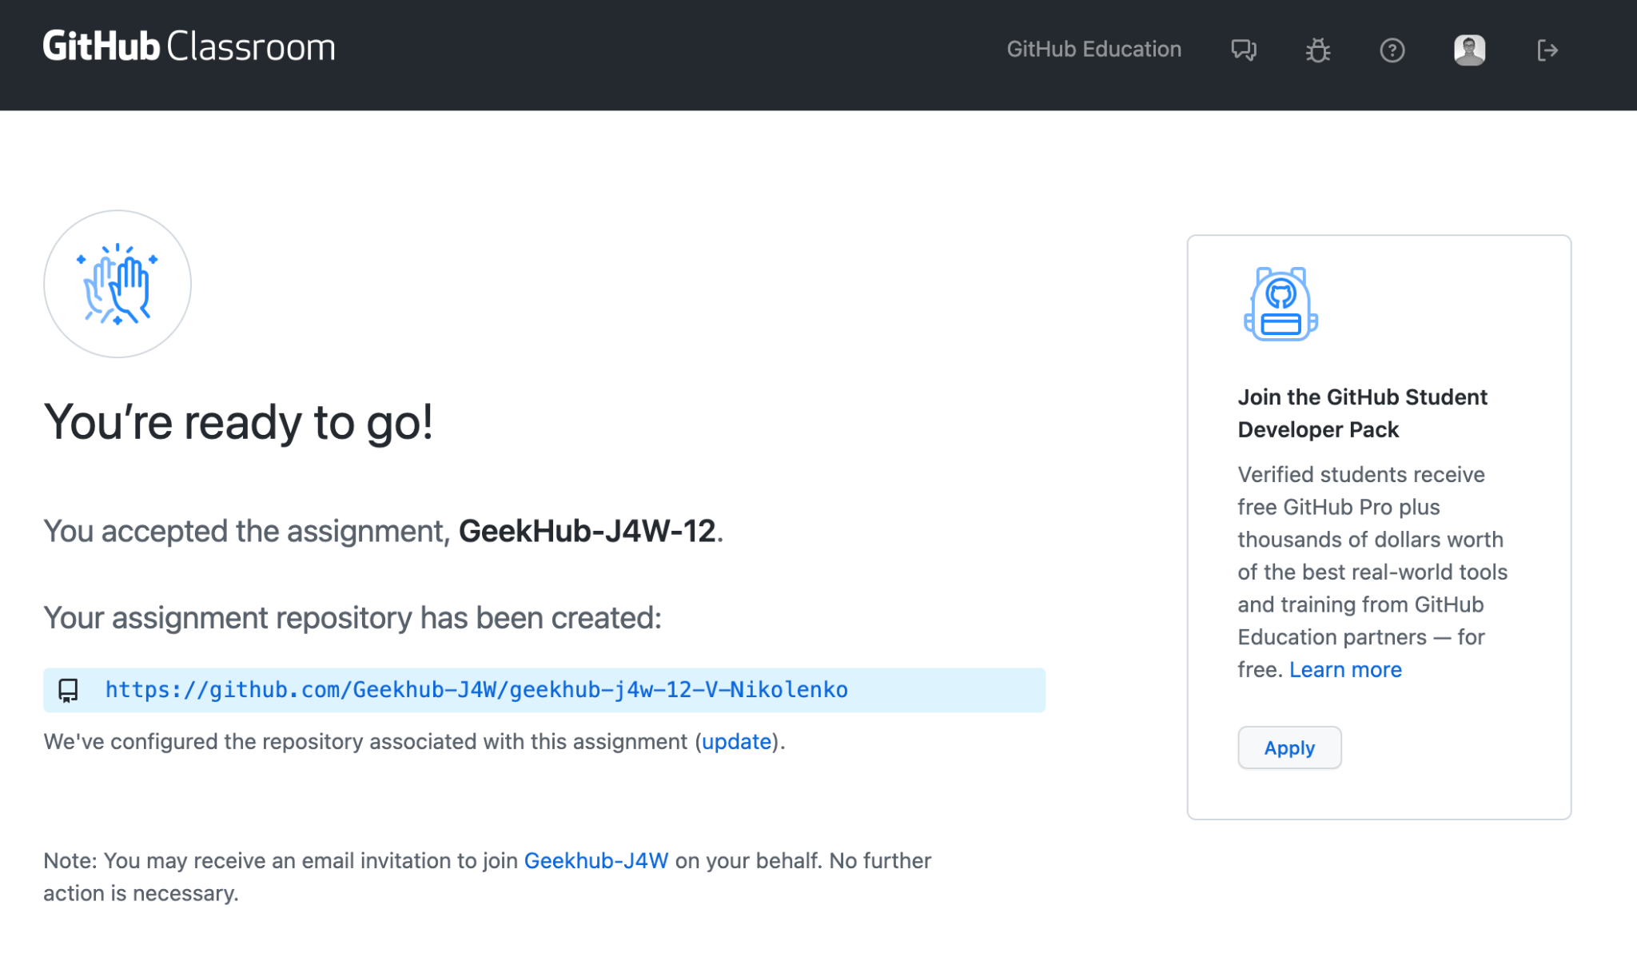
Join GitHub classroom

Slide 23
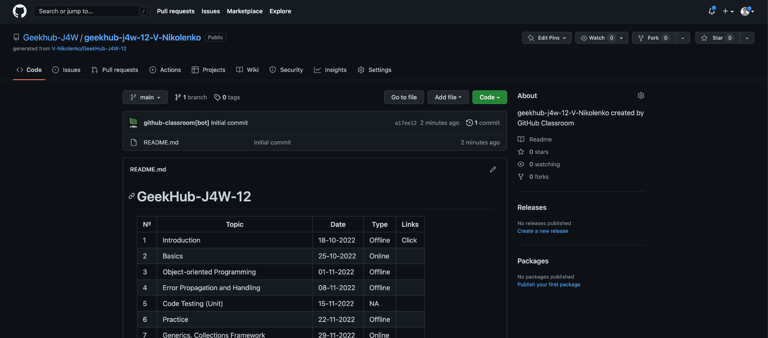
Join GitHub classroom

Slide 24
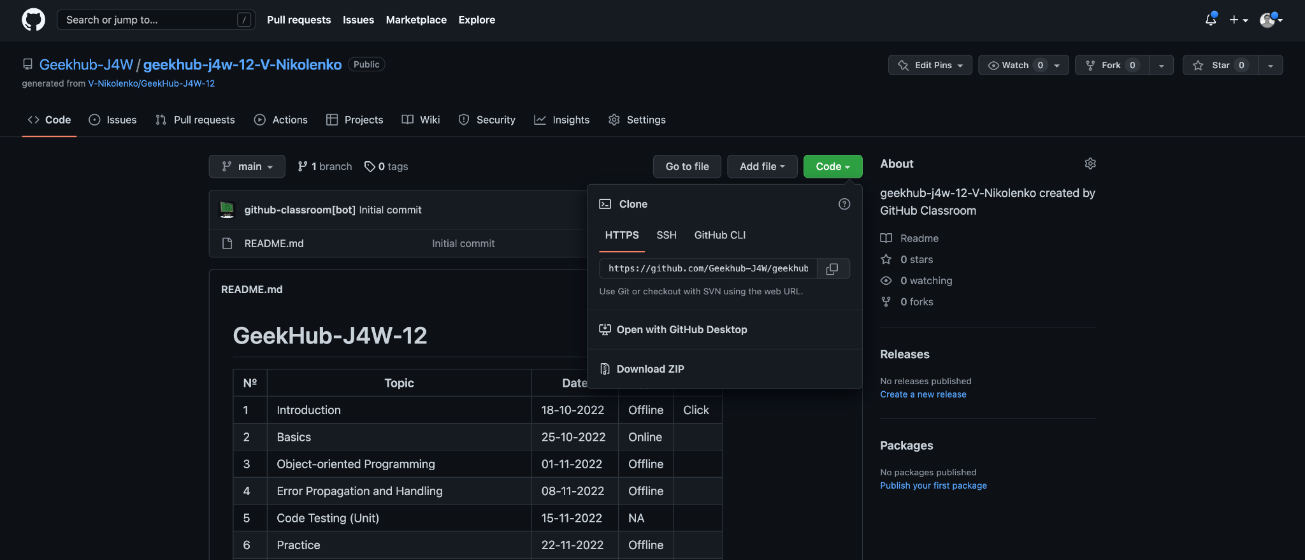
Join GitHub classroom

Slide 25
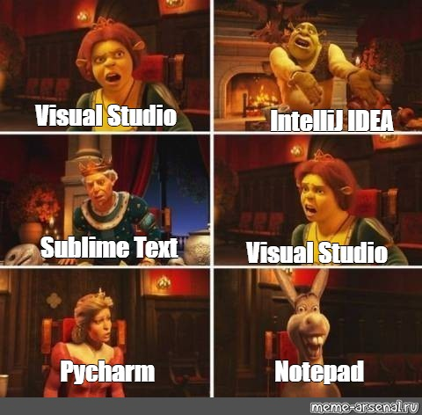
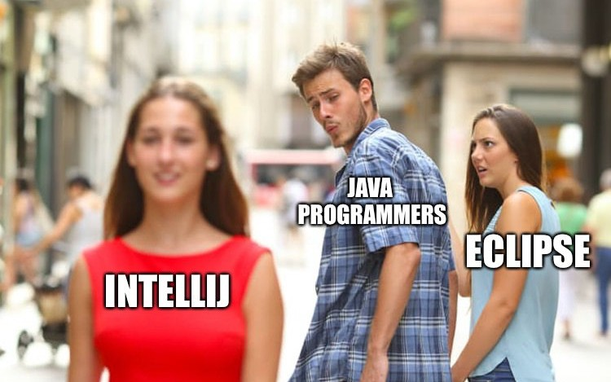
Intellij IDEA
Download Intellij IDEA Community from official website.

Slide 26
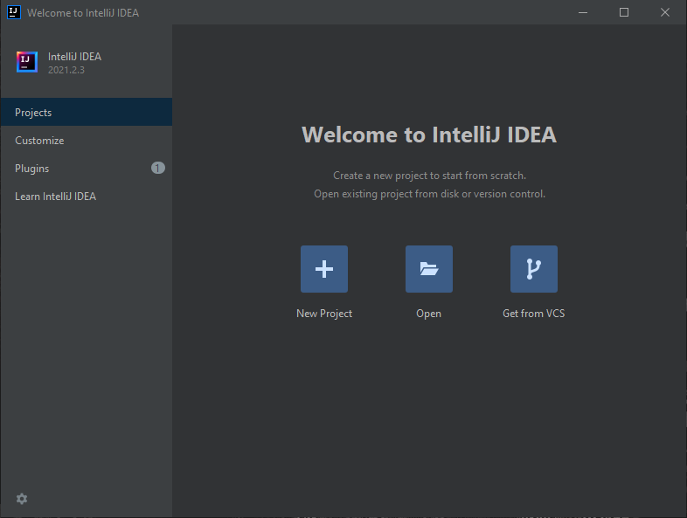
Import project into IDEA
Open IntelliJ IDEA
Choose “Get from VCS”
Choose “Git”

Slide 27
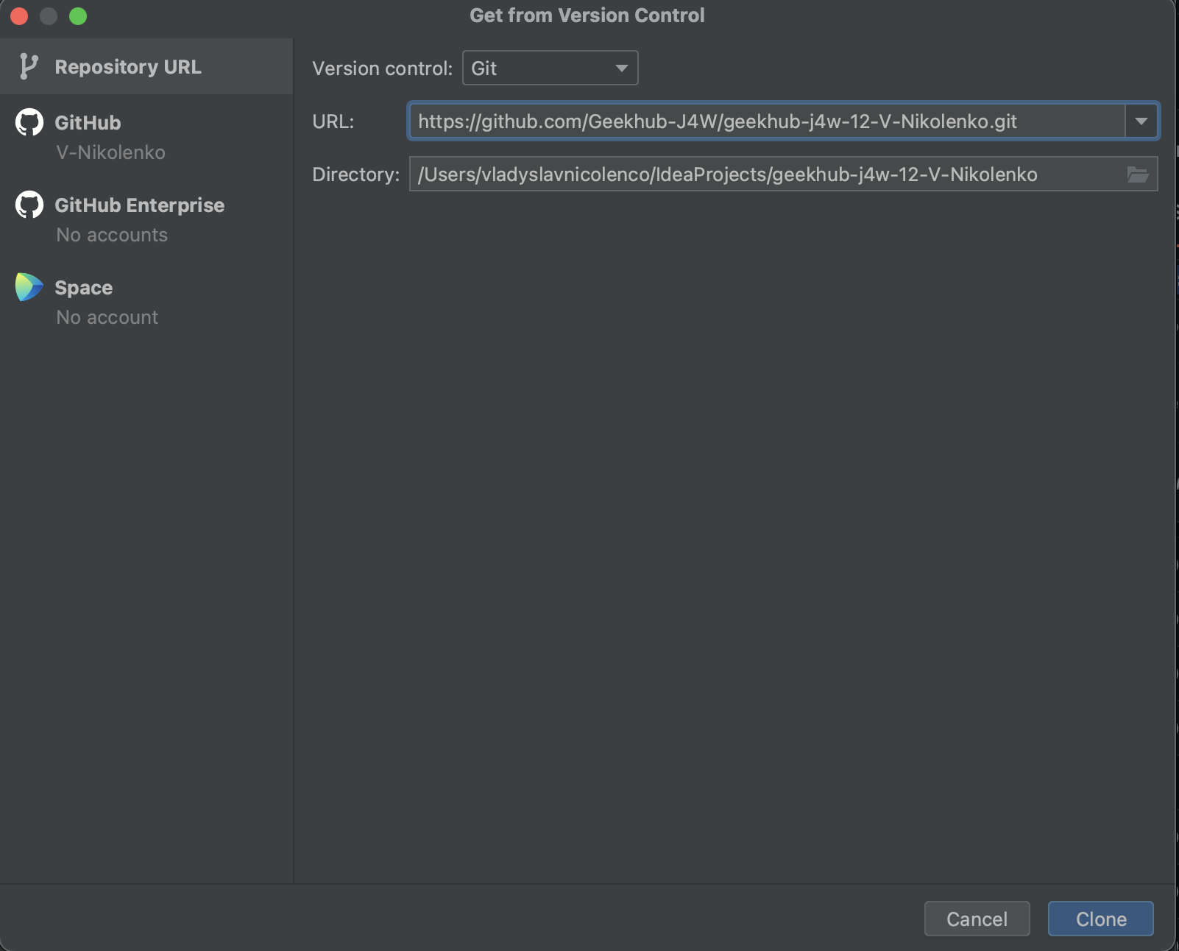
Import project into IDEA
4. Paste copied link of the repository into just opened window
5. Click “Clone”

Slide 28
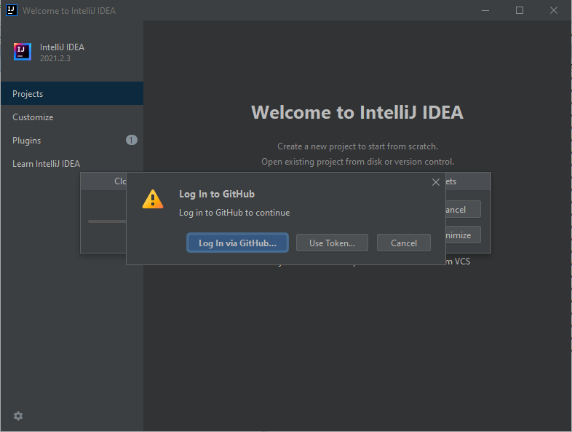
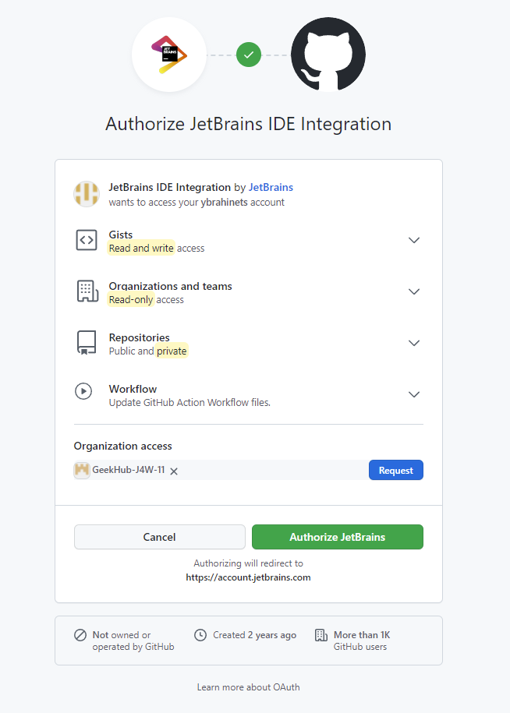
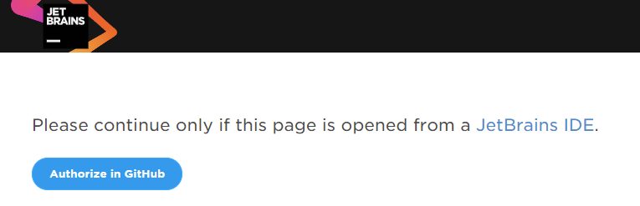
Import project into IDEA
6. Input your login and password (or token) for
GitHub.com if required

Slide 29
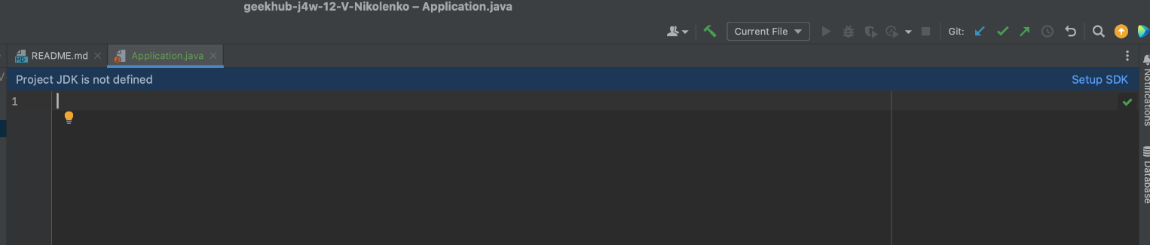
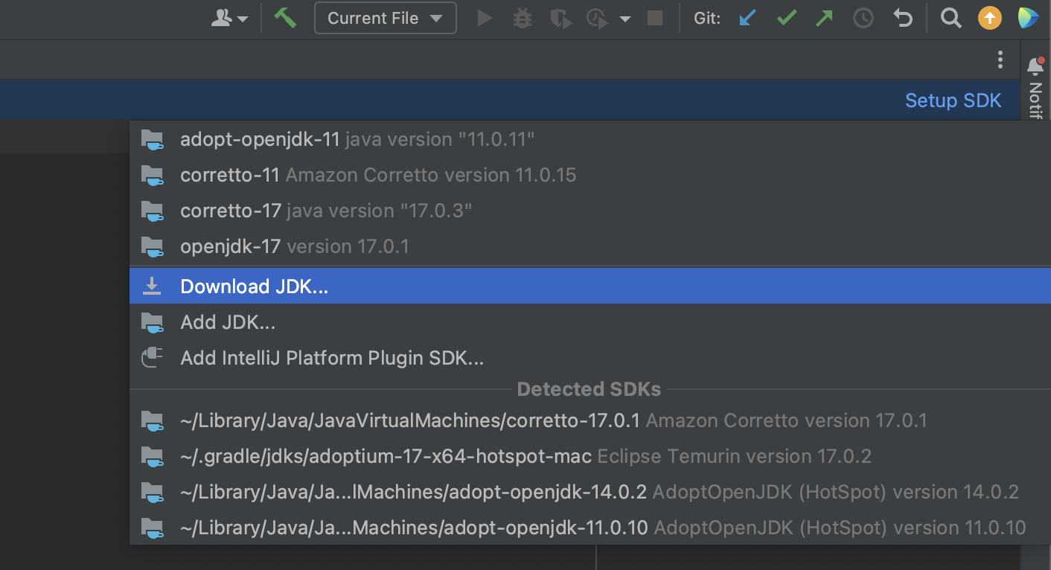
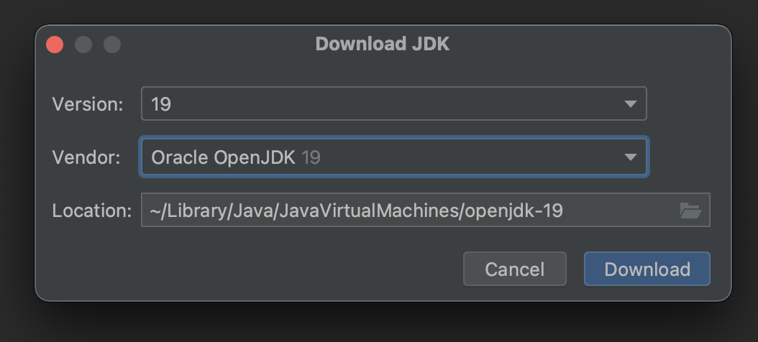
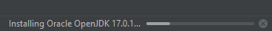
Setup SDK

Slide 30
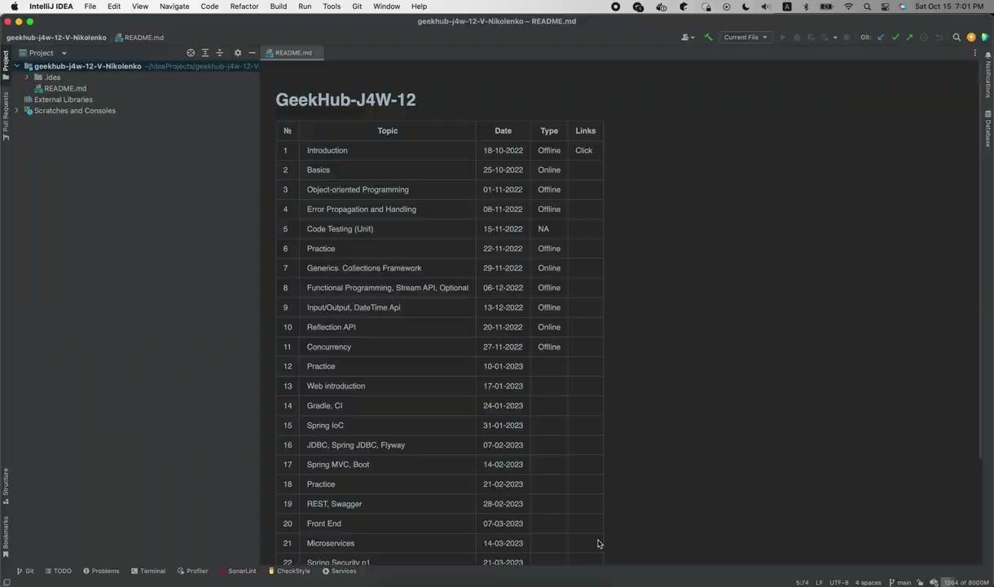
Setup JDK
Open project in IDEA
Choose “Project” tab
Add new JDK for IDEA
Choose JDK 17 for your project
Choose latest “Project language level”
Click “OK”

Slide 31
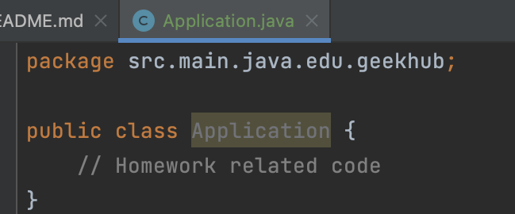
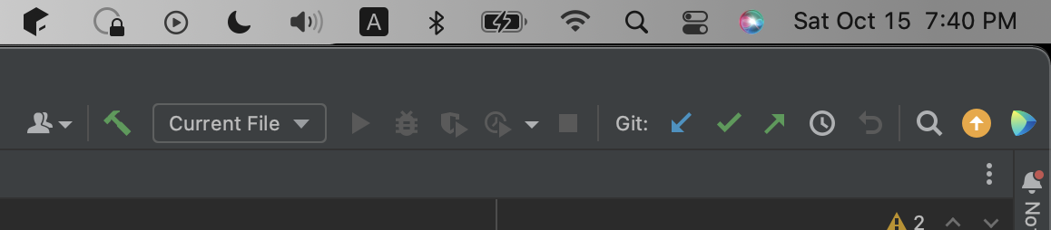
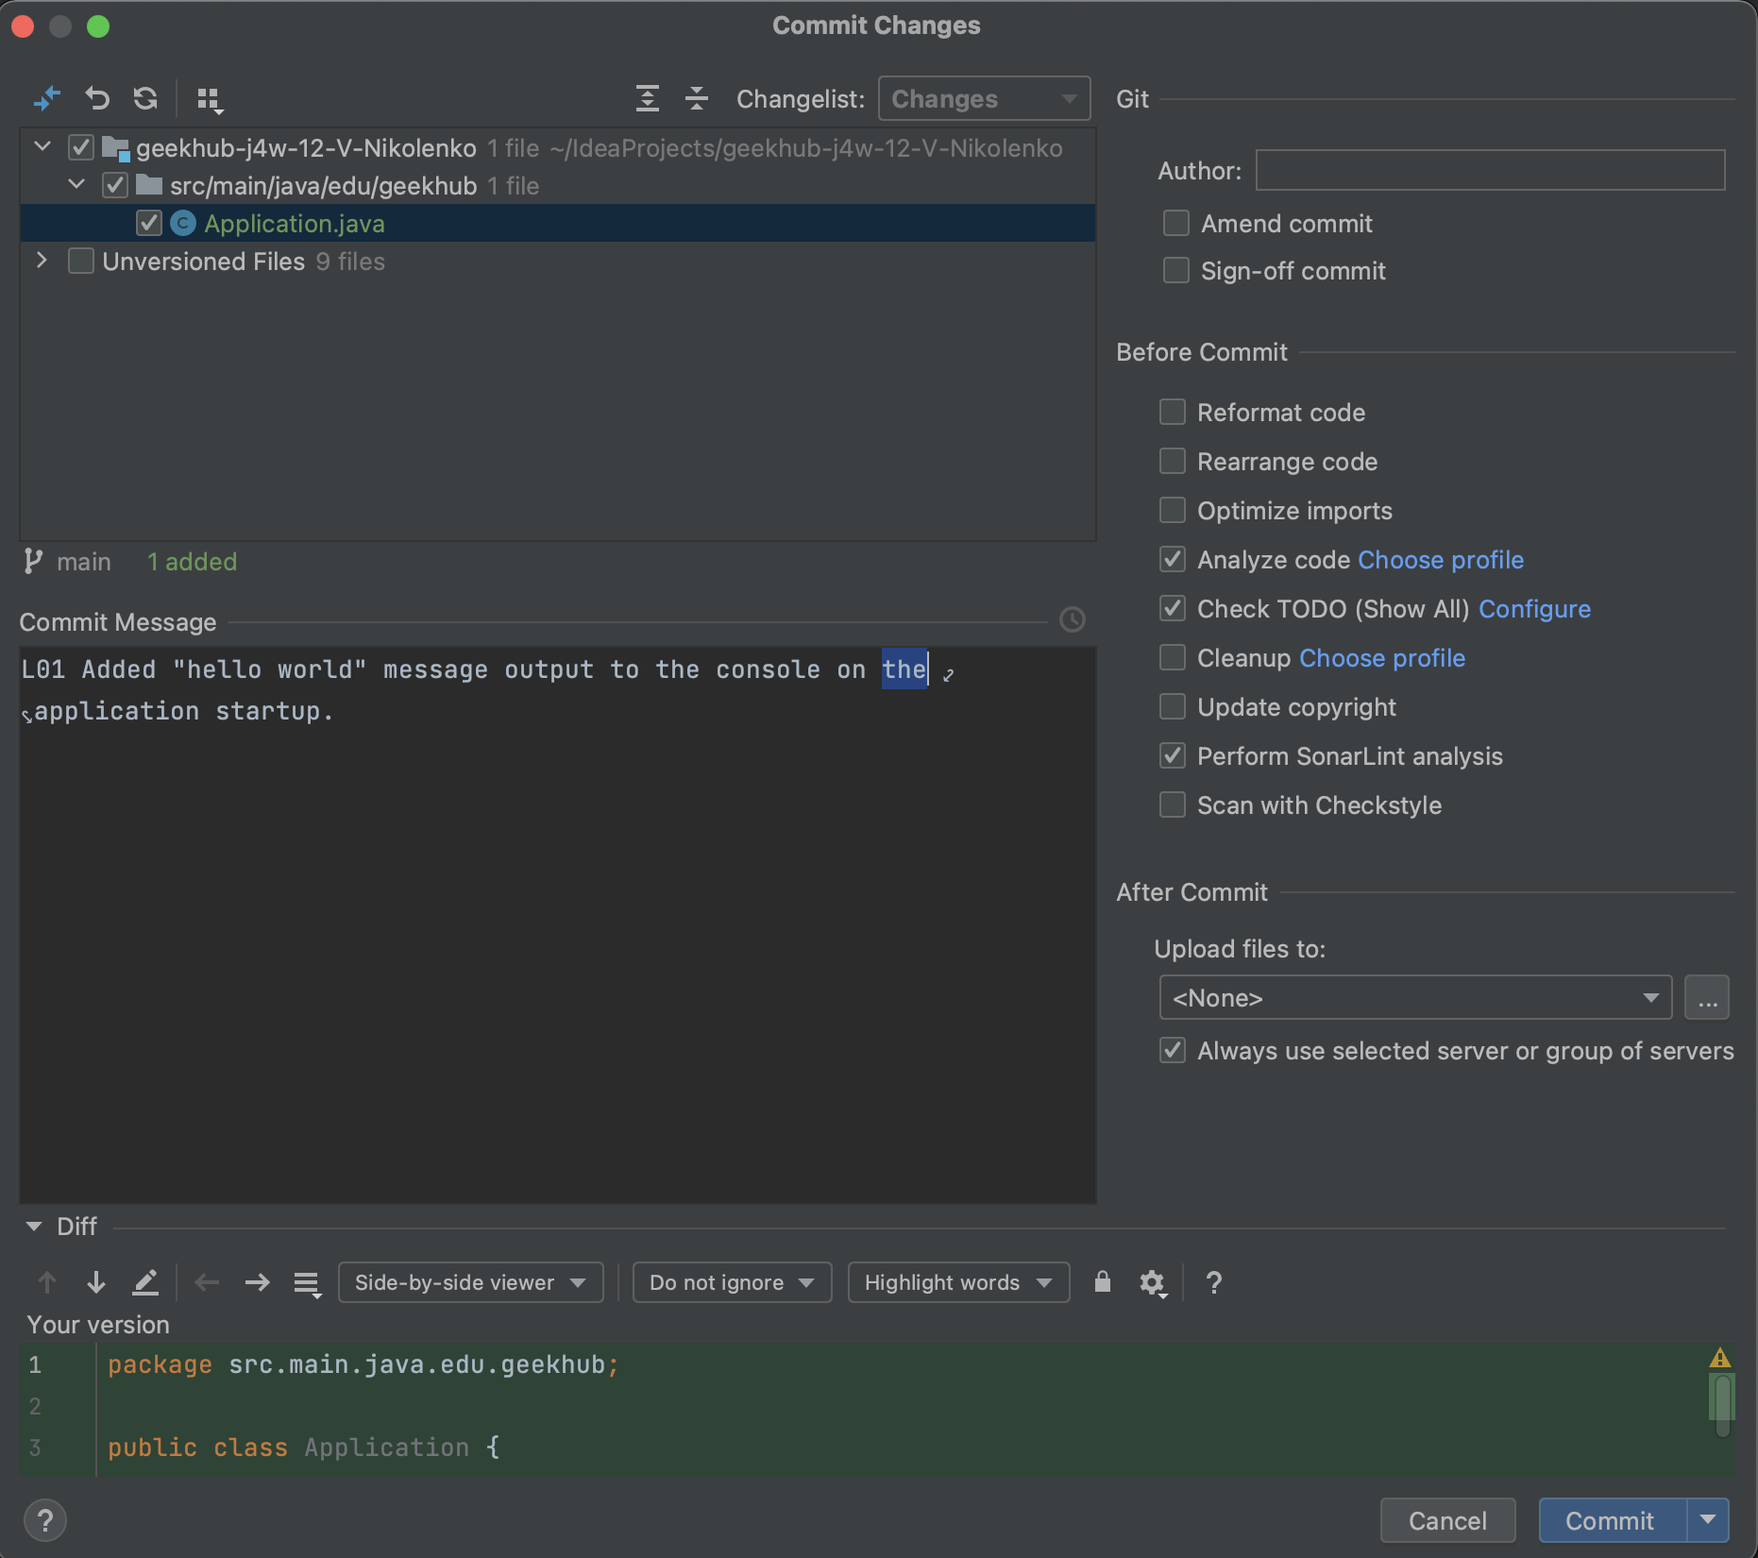
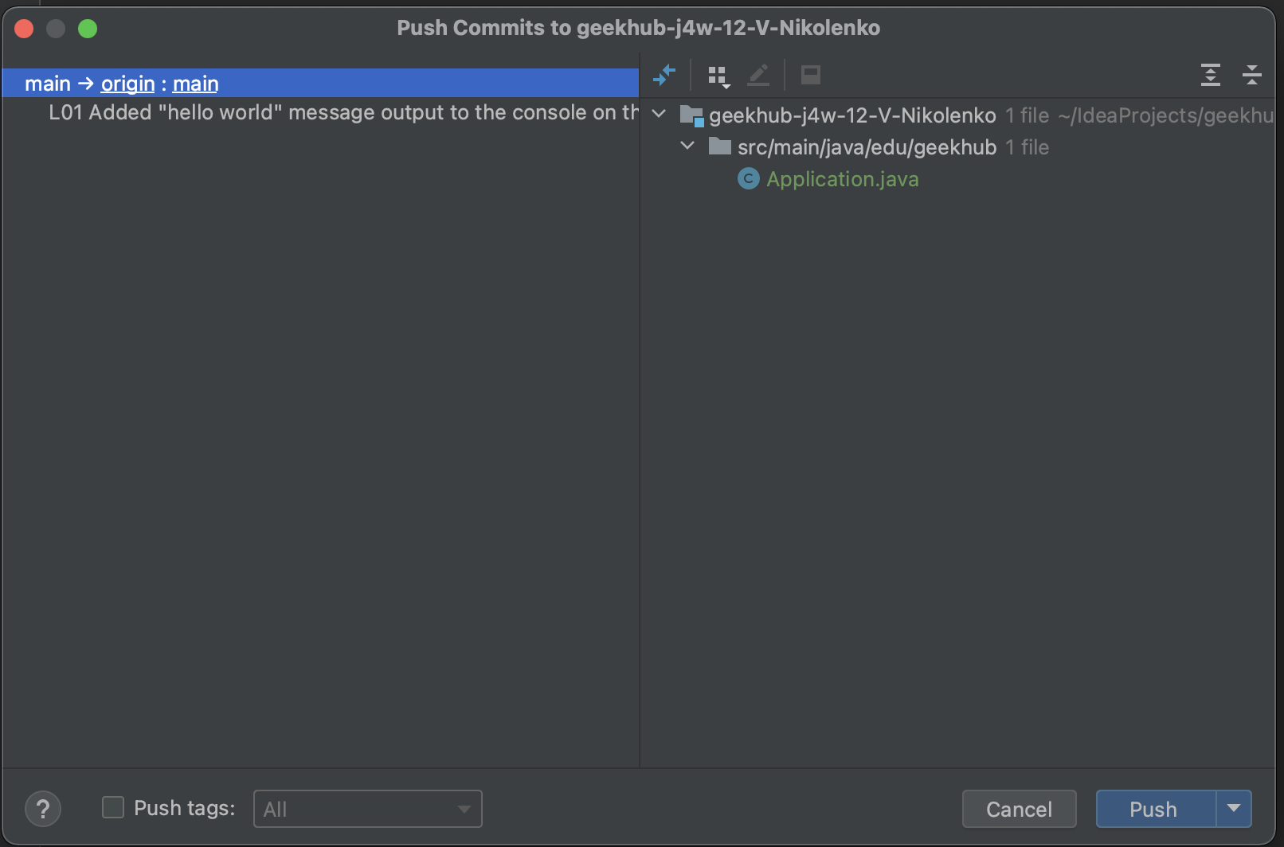
First Commit and Push to Git
You have made some changes, it’s time to commit and push
Press “Ctrl+K” to make commit
Choose files that should be committed
Type understandable and informative “L## Commit Message”
Check checkboxes: “Perform code analysis”, “Check TODO” and “Scan with CheckStyle”
Click “Commit”

Slide 32

First Commit and Push to Git
Read info about .gitignore
Find .gitignore file in a root of project folder
Add missing lines:
.idea
*.iml
out/
build/
classes/
.gradle
/libs/

Slide 33
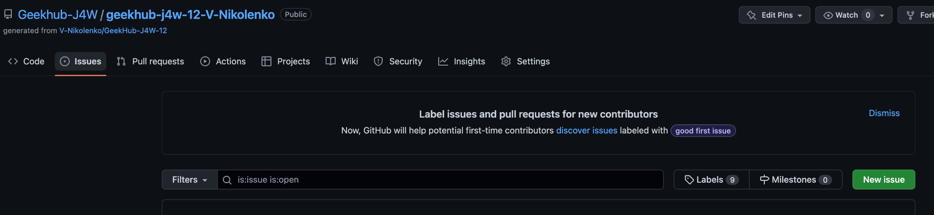
Create issue

Slide 34
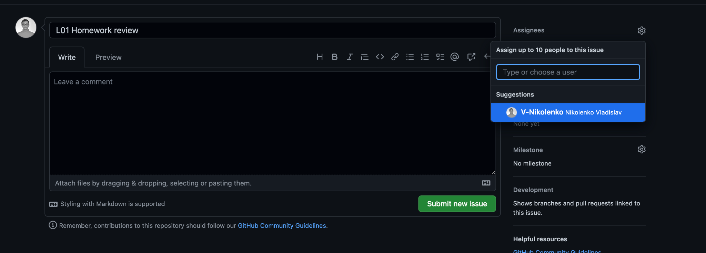
Create issue
Title: L## Homework Review
Assignee: Lector that was on lection

Slide 35

Homework
Required:
Download Intellij IDEA Community
Install Git on your computer
Create a new account on GitHub
Join Slack channel
Implement and push a Hello World greeting program
Create a GitHub issue with successful program execution. Assign it to lector
Optional:
Configure checkstyle for IDEA
Configure editorconfig for IDEA
Install SonarLint plugin in your IDEA
Complete .gitignore configuration

Slide 36

Questions & Answers

Slide 37
Literature
Gamified git tutorial from Stanford
Pro Git
Git Setup

Slide 38
Thanks!
Find us in Slack:
@Bohdan Cherniak
@Vladyslav Nikolenko
@Volodymyr Vedula

